Slide 1
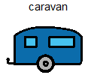
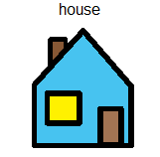
June 2019
1
2
3
4
5
6
7
8
9
10
11
12
13
14
15
16
17
18
19
20
21
22
23
24
25
26
27
28
29
30

Slide 2
July 2019
1
2
3
4
5
6
7
8
9
10
11
12
13
14
15
16
17
18
19
20
21
22
23
24
25
26
27
28
29
30
31

Slide 3
June 2019
1
2
3
4
5
6
7
8
9
10
11
12
13
14
15
16
17
18
19
20
21
22
23
24
25
26
27
28
29
30

Slide 4
July 2019
1
2
3
4
5
6
7
8
9
10
11
12
13
14
15
16
17
18
19
20
21
22
23
24
25
26
27
28
29
30
31

